Slide 1
Chapter 11: Test Bias

Slide 2
Introduction (1 of 2)
Response bias: Deals w/ individuals’ specific patterns of responding (last week’s class!)
Test bias: Obscures differences among groups.
Reminder: Psychological testing is used to make all sorts of decisions that impacts people’s lives
What happens if a test is biased against certain groups?
Notes:
Test bias: Obscures the differences among groups of respondents.
Role of decisions affecting lives of people:
Through psychological tests, we can make important decisions that affect our lives.
To the degree that such decisions are based on tests that are biased for, or against, specific groups of people, such biases have extremely important personal and societal implications.
Forms of test bias:
Construct bias or measurement bias or internal bias:
Occurs when a test has different meanings for two groups.
Concerns the relationship of observed scores to true scores on a psychological test.
Can lead to situations in which two groups have the same average true score but different averages on observed scores on a test of the construct.
Predictive bias or differential validity or external bias:
Occurs when a test’s use has different implications for two groups.
Concerns the relationship between scores on two different tests.
The predictor test might provide values that can be used to predict scores on the outcome test.
Methods used to detect test score bias:
Internal methods to detect construct bias.
External methods to detect predictive bias.

Slide 3
Introduction (2 of 2)
Two Types of test bias:
  Construct Bias (measurement bias/internal bias)
    Test has different meanings for two groups
    Two groups could have same “true” score but very different test scores
    Example: Cultural differences and IQ testing
  Predictive Bias (external bias)
    Test has different implications for two groups
    Example: A personality inventory is a good predictor of test performance, but only for people under 40
Notes:
Test bias: Obscures the differences among groups of respondents.
Role of decisions affecting lives of people:
Through psychological tests, we can make important decisions that affect our lives.
To the degree that such decisions are based on tests that are biased for, or against, specific groups of people, such biases have extremely important personal and societal implications.
Forms of test bias:
Construct bias or measurement bias or internal bias:
Occurs when a test has different meanings for two groups.
Concerns the relationship of observed scores to true scores on a psychological test.
Can lead to situations in which two groups have the same average true score but different averages on observed scores on a test of the construct.
Predictive bias or differential validity or external bias:
Occurs when a test’s use has different implications for two groups.
Concerns the relationship between scores on two different tests.
The predictor test might provide values that can be used to predict scores on the outcome test.
Methods used to detect test score bias:
Internal methods to detect construct bias.
External methods to detect predictive bias.

Slide 4
Why Worry about Test Score Bias?
Education:
  College entrance exams, GRE, etc.
IQ Testing:
  Special education programs, legal decisions (think murder trials)
Hiring decisions
Notes:
Tests taken by students and applicants:
Academic achievement tests are take by all school children.
The SAT or American College Testing (ACT) test is taken by the students who plan to attend an institution of higher education.
Graduate Record Exam (GRE) is taken by the students who plant to attend graduate schools.
Applicants for most federal government jobs are evaluated using psychological tests.
Use of intelligence test scores in education and legal system:
In educational settings, these scores help place children in special programs.
In legal system, they are used to make decisions of sentencing people to death following a murder conviction.
Use of standardized test scores in education and corporations:
In educational institutions, these scores are used to make admission decisions.
Most public school teachers in the United States must pass these tests to become certified school teachers.
In corporations and governments, they are used to make job decisions about people.
The desire for unbiased test scores:
Because testing has important consequences, we desire to have unbiased tests that allow us to differentiate among people based on real psychological differences and not irrelevant factors such as biological sex, ethnicity, race, religious preference, age, or any other such quality.
This desire is rooted in the belief that we should not discriminate for or against a person.

Slide 5
Detecting Construct Bias: Internal Evaluation of a Test (1 of 9)
Construct Bias (Measurement Bias): Deals w/ meaning of test scores
Key goal of testing?
  to detect psychological variability!
Evaluating bias?
  Do people from two groups consistently respond differently to certain items?
  Are group differences related at all to what the test is measuring?
Composite tests: tests with multiple items.
  Look at general patterns of responding to similar items!
Notes:
Construct bias:
It is related to the meaning of test scores.
If a test has construct bias, then its scores might have different meanings for different groups of people.
Key goal of testing: To detect psychological variability in terms of differences between people.
Examining responses to individual items:
We can evaluate construct bias by examining responses to individual items on a test.
An item on a test is biased if:
People belonging to different groups respond in different ways to the item.
These differing responses were not related to group differences in the psychological attribute measured by the test.
Composite tests:
These tests contain multiple items or questions and their overall degree of bias is determined by the bias associated with each of the items in the test.
If none of the test items are biased, then the total test score is unbiased.
If any of the test items seem to be biased, then the test score is biased.

Slide 6
Detecting Construct Bias: Internal Evaluation of a Test (2 of 9)
Construct bias: item == biased if responses only reflect true scores of one group, not both
Internal structure of the test: Pattern of correlations among items
Does the internal structure differ between two groups?
  If yes, test is probably biased
Notes:
Differences in responses based on true scores: In terms of construct bias, a test item would be biased if responses to the item for people who belong to one group reflect their true scores on the relevant psychological attribute but responses to the item for people who belong to another group do not.
Internal structure of the test: The pattern of correlations among items and/or the correlations between each item and the total test score.
Examining internal structure of the test:
We can evaluate the presence of construct bias by examining the internal structure of a test separately for two groups.
If same internal structure is exhibited by the two groups, then the test is unlikely to suffer from construct bias.
If different internal structures are exhibited by the two groups, then the test might suffer from construct bias.

Slide 7
Detecting Construct Bias: Internal Evaluation of a Test (3 of 9)
What about reliability?
  Also can be estimated via internal consistency.
Differences in reliability between two groups?
  Test doesn’t work the same way between groups
  Test may be more precise for one group
Notes:
Estimation through internal consistency:
Reliability can be estimated through internal consistency.
Internal consistency reliability is based upon the consistency among the parts of a test and it provides some insight into the internal structure of a test.
Fact suggested by group differences in reliability:
The test is not working in the same way in the two groups.
If the scores are more reliable in one group than in another, then the test provides observed scores that are more precise in one group than in the other.
Indices of reliability: alpha and omega: While early work focused on developing tests to compare group differences in coefficient alpha, recent work presents procedures for testing group differences in omega.

Slide 8
Detecting Construct Bias: Internal Evaluation of a Test (4 of 9)
Item Response Theory (IRT): Estimating trait levels directly from test data
  Trait levels: participants’ true scores for psychological attribute.
Basic idea: There is a math function that relates true trait levels to the probability that a participant will answer in a certain way
Don’t worry about the math ☺
Notes:
Differential item functioning analysis: It is a feature of a psychometric approach called item response theory (IRT) which assumes that it is possible to estimate respondents’ trait levels directly from test data.
Trait levels: Participants’ true scores for the psychological attribute that is being measured.
Idea behind item response theory: It is possible to find a mathematical function relating a participant’s trait level to the probability that the participant will answer a particular test question in a certain way.
Item characteristic curve (ICC):
Represents the connection between trait levels and the probability that a respondent will answer an item correctly.
Can be generated using specialized statistical software and the mathematical function.

Slide 9
Detecting Construct Bias: Internal Evaluation of a Test (5 of 9)
Item characteristic curve (ICC)
  Plots the connection between trait levels and the probability of an answer being correct (for the “true” trait level)
  Generated via computer programs (or by hand if you hate yourself)
Notes:
Differential item functioning analysis: It is a feature of a psychometric approach called item response theory (IRT) which assumes that it is possible to estimate respondents’ trait levels directly from test data.
Trait levels: Participants’ true scores for the psychological attribute that is being measured.
Idea behind item response theory: It is possible to find a mathematical function relating a participant’s trait level to the probability that the participant will answer a particular test question in a certain way.
Item characteristic curve (ICC):
Represents the connection between trait levels and the probability that a respondent will answer an item correctly.
Can be generated using specialized statistical software and the mathematical function.

Slide 10
Detecting Construct Bias: Internal Evaluation of a Test (6 of 9)
ICC Curve Basics
  Trait levels framed in terms of z scores.
  Negative z-scores == less trait, positive == more trait, 0 =?
  Highter trait == more likely to answer item correctly
What about bias?
  Can compare ICC curves between different groups
  Do they differ in a way that isn’t based on theory/tested attributes?
Notes:
Trait levels framed in terms of z scores:
ICCs have trait levels framed in terms of z scores.
Negative z scores represent relatively low trait levels and positive z scores represent higher trait levels.
Respondents who have higher trait have a greater probability of answering the test item correctly.
Evaluating construct bias using ICC:
This is done by obtaining an item’s ICC separately for each group and comparing ICCs from the two groups.
The ICCs obtained separately for each group illustrate the link between trait levels and item responses within each group.
If an item’s ICCs are very similar across the two groups, then the item does not suffer from construct bias.
However, if an item’s ICCS are different across the two groups, then the item is likely to suffer from construct bias.
Downside of IRT analyses: There are issues regarding the following:
The appropriate model to use.
The procedures for determining whether the estimated differences between groups reflect “real” differences or not.
The need for very large sample sizes.
The need for item samples and samples of people that are heterogeneous enough to represent the complete range of traits the test is designed to measure.
The need for specialized statistical software to conduct the analyses.

Slide 11
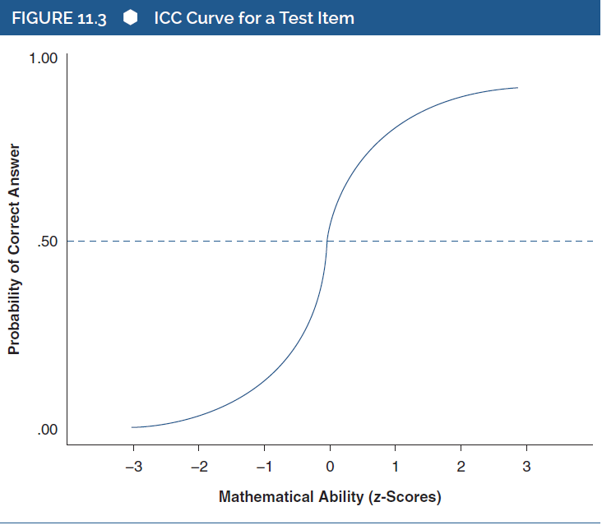
Detecting Construct Bias: Internal Evaluation of a Test (7 of 9)
Notes:
Figure 11.3: ICC curve for a test item.

Slide 12
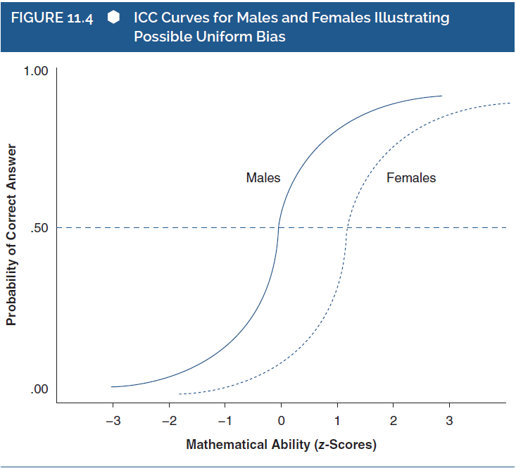
Detecting Construct Bias: Internal Evaluation of a Test (8 of 9)
Notes:
Figure 11.4: ICC curves for males and females illustrating possible uniform bias.
Uniform bias: Occurs when two people have the same level of ability but are not equally likely to answer the item correctly.
In this figure, a female is less likely than male with the same math ability to answer the item correctly.
For a male whose math ability is 1 standard deviation above the mean, he has approximately an 80% chance of answering the item correctly.
However, a female who has the same level of math ability has only about a 25% chance of answering correctly.

Slide 13
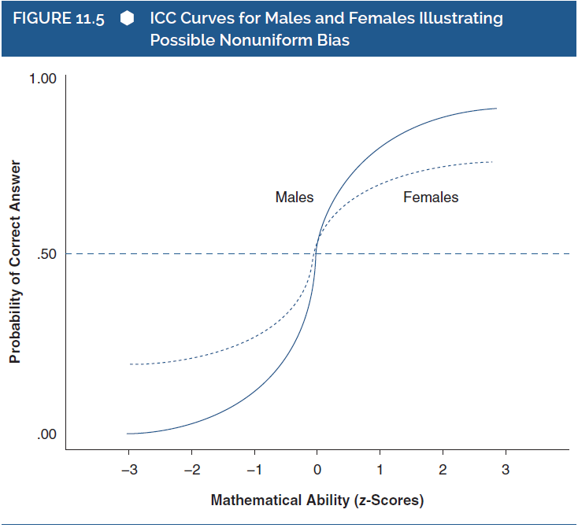
Detecting Construct Bias: Internal Evaluation of a Test (9 of 9)
Notes:
Figure 11.5: ICC curves for males and females illustrating possible nonuniform bias.
Nonuniform bias: A situation in which the ICCs differ in shape as well as location.
In this case, at some levels of math ability, females are more likely to answer the item correctly than are males who have the same level of ability.
However, at other levels of ability, females are less likely to answer the item correctly than are males who have the same level of ability.

Slide 14
Detecting Predictive Bias: External Evaluation of a Test (1 of 9)
Predictive Bias: Degree to which test scores are predictive. Is it better at predicting trait for certain groups?
A question of fairness, important implications for people’s lives!
“One-size-fits all” assumption
  Test should be equally predictive for all groups
  Assumption is then tested
Notes:
Predictive bias:
It concerns the degree to which a test’s scores are equally predictive of an outcome for two groups.
If a test is more predictive for some groups than for others, then it suffers from predictive bias.
A great concern in applied psychological and educational measurement:
Organizations might make important decisions about hiring individuals on the basis of test scores.
Such decisions can have important implications for those individuals’ lives, for the organizations themselves, and for society.
Hence, test users are concerned about the possibility that test scores might be biased for or against some entire groups of people.
For tests used in such applied testing contexts, there is great concern about predictive bias.
Detection of bias via assumption of one size fits all:
Predictive bias is detected by first making the assumption that “one size fits all,” that is, the test is equally predictive for all groups.
This assumption is then formally evaluated by conducting analyses.
If analyses confirm that the test is equally predictive for both groups, then the test does not suffer from predictive bias.
If analyses indicate that predictor test scores are not equally predictive for both groups, then the test might suffer from predictive bias.
Considerations to evaluate efficacy and predictive bias of a test:
Get participants’ scores on the test.
Obtain their scores on the measure of a relevant criterion.
Know each participant’s gender.

Slide 15
Detecting Predictive Bias: External Evaluation of a Test (2 of 9)
To test for predictive bias:
  Get test scores for at least two groups
  What is the relevant criteria? (What is the outcome?)
  Consider which factors to group people by (race, ethnicity, gender, SES, etc.)
Notes:
Predictive bias:
It concerns the degree to which a test’s scores are equally predictive of an outcome for two groups.
If a test is more predictive for some groups than for others, then it suffers from predictive bias.
A great concern in applied psychological and educational measurement:
Organizations might make important decisions about hiring individuals on the basis of test scores.
Such decisions can have important implications for those individuals’ lives, for the organizations themselves, and for society.
Hence, test users are concerned about the possibility that test scores might be biased for or against some entire groups of people.
For tests used in such applied testing contexts, there is great concern about predictive bias.
Detection of bias via assumption of one size fits all:
Predictive bias is detected by first making the assumption that “one size fits all,” that is, the test is equally predictive for all groups.
This assumption is then formally evaluated by conducting analyses.
If analyses confirm that the test is equally predictive for both groups, then the test does not suffer from predictive bias.
If analyses indicate that predictor test scores are not equally predictive for both groups, then the test might suffer from predictive bias.
Considerations to evaluate efficacy and predictive bias of a test:
Get participants’ scores on the test.
Obtain their scores on the measure of a relevant criterion.
Know each participant’s gender.

Slide 16
Detecting Predictive Bias: External Evaluation of a Test (3 of 9)
Two issues to be examined after getting information.
  Does the test actually predict the outcome?
  Does it predict the outcome equally for both groups?
How to test? Regression modeling!
  Can use test scores to predict the relevant criteria
Notes:
Two issues to be examined after getting information:
Does the test actually help us predict the relevant criterion?
Does it predict the relevant criterion equally well for various groups of trainees?
Regression: A statistical procedure to address the two issues: This allows us to use the test scores to calculate predicted scores of the relevant criterion.

Slide 17
Detecting Predictive Bias: External Evaluation of a Test (4 of 9)
Regression Basics:
  Assumption: linear relationship between test scores and criterion scores.
  Formula for straight line: Ĉ = a + b(T). (y = bx + e)
Use SPSS
Evaluating predictive ability of the test?
  Take the test scores (T), plug into the formula, and generate a C score for each individual.
  Does mean C differ between groups?
Notes:
Assumption of regression analysis: There is a linear relationship between test scores and criterion scores.
Formula for straight line:
Ĉ = a + b(T) where:
Ĉ is the predicted training criterion score for an individual training candidate,
a is the intercept,
b is the regression coefficient or slope, and
T is an individual’s aptitude test score.
This formula can be used to predict criterion scores from test scores.
Use of software packages: We can use software packages such as SPSS and SAS to conduct the regression analysis, which produces values of a and b.
Evaluating predictive ability of the test: This is done by taking any individual’s score on the test (T), plugging it into the regression equation, and calculating a predicted score on the criterion (Ĉ) for that individual.

Slide 18
Detecting Predictive Bias: External Evaluation of a Test (5 of 9)
Trainee | Aptitude Test Score | Supervisor Rating | Predicted Supervisor Rating
1 | 32 | 75 | 74.59
2 | 40 | 80 | 79.23
3 | 57 | 81 | 89.09
4 | 60 | 98 | 90.83
Notes:
Table 11.1: Data illustrating regression analysis.

Slide 19
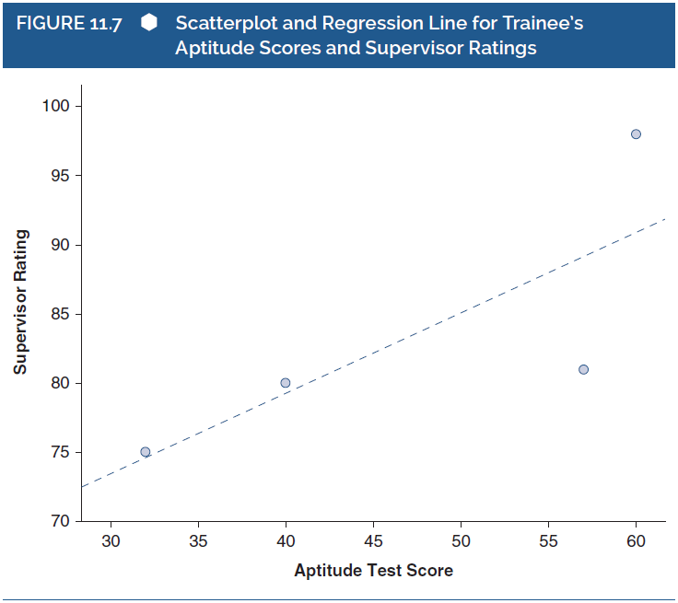
Detecting Predictive Bias: External Evaluation of a Test (6 of 9)
Notes:
Figure 11.7: Scatterplot and regression line for trainee’s aptitude scores and supervisor ratings.

Slide 20

Detecting Predictive Bias: External Evaluation of a Test (7 of 9)
Intercept Bias
Where does line cross y axis?
Different baselines
Notes:
Figure 11.8: Regression lines for males and females in relation to the common regression line illustrating possible intercept bias.
If a test suffers only from intercept bias, then the size of the group discrepancy is constant across all aptitude scores.
This figure shows that a male trainee of a given aptitude level will obtain a predicted rating that is always 4 points higher than a female who has the same level of aptitude.

Slide 21

Detecting Predictive Bias: External Evaluation of a Test (8 of 9)
Slope Bias
Changes occur at different rates
Notes:
Figure 11.9: Regression lines for males and females in relation to the common regression line illustrating possible slope bias.

Slide 22

Detecting Predictive Bias: External Evaluation of a Test (9 of 9)
Intercept and Slope Bias
Changes occur at different rates
AND
Groups have different baselines
Notes:
Figure 11.10: Regression lines for males and females in relation to the common regression line illustrating possible slope and intercept bias.
Intercept and slope bias: Occurs when there is a complex relationship between the test scores and the outcome scores for the different groups.

Slide 23
Test Fairness
Test Bias:
  Psychometric concept based on validity of scores
  Can be assessed via statistical methods
Test fairness:
  Deals with appropriate use of test scores
  More of social/philosophical/legal issue
Both are important to consider!
Bias → unfairness
Notes:
Distinguishing between test bias and test fairness:
Test bias:
A psychometric concept embedded in theories of test score validity.
Defined within psychometric theories, and detectable through specific statistical and research methods.
Test fairness:
Not a psychometric property of a test.
Concerns with the appropriate use of test scores.
A social, philosophical, or legal term representing a person’s value judgment.
Test fairness is an important issue in psychological testing:
This is because testing concerns with procedures for selecting, administering, and interpreting test scores in an applied setting.
Individuals who give and use psychological tests are familiar with the psychometric properties of those tests.
What those individuals do with the test scores might influence someone’s judgment concerning the fairness of the test.
Moreover, a test that has strong psychometric properties might be misused to make judgments that are not fair.
Psychometric properties of tests must be one factor:
It is important that the psychometric properties of tests, including information about potential test score biases, are one factor that informs the use of tests in applied settings.
However, people’s beliefs about the fairness of the use of test scores might or might not be influenced by those psychometric properties.

